Slide 1
Python Programming

Slide 2
Template Syntax
{% %} {% %} – template tags
{{ }} – a variable

Slide 3
Template tags and filters
Django codes inside the HTML

Slide 4
Template tags {% comment %} {% endcomment %}
{% comment %}
<p>Ignore me</p>
{% endcomment %}

Slide 5
Template tags {% csrf %}
This tag is used for CSRF protection
Place this tag inside the form tag

Slide 6
Template tags {% for %} {% endfor %}
List:
{% for hair in hairs %}
<p>{{ hair }}</p>
{% endfor %}
Dictionary:
{% for key, value in data.items %}
{{ key }} {{ value }}
{% endfor %}

Slide 7
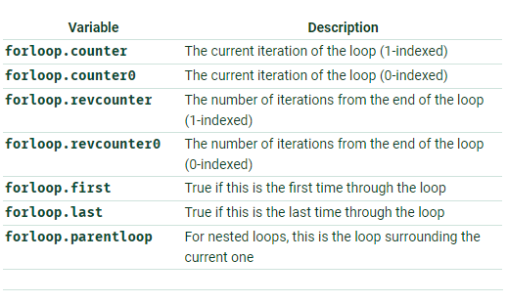
Template tags {% for %} {% endfor %}

Slide 8
Template tags {% for %} {% endfor %}
{% for hair in hairs %}
{{ forloop.counter }}
{% endfor %}

Slide 9
Template tags {% for %} {% empty %}
<ul>
{% for athlete in athlete_list %}
<li>{{ athlete.name }}</li>
{% empty %}
<li>Sorry, no athletes in this list.</li>
{% endfor %}
</ul>

Slide 10
Template tags {% if %}
{% if athlete_list and coach_list %}
Both athletes and coaches are available.
{% endif %}
{% if not athlete_list %}
There are no athletes.
{% endif %}
{% if not athlete_list or coach_list %}
There are no athletes or there are some coaches.
{% endif %}

Slide 11
Template tags {% url %}
{% url 'some-url-name' v1 v2 %}
url name arguments
{% url ‘some-namespace:some-url-name’ %}
namespace url name

Slide 12
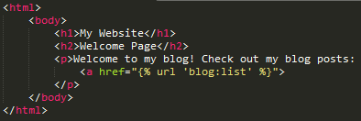
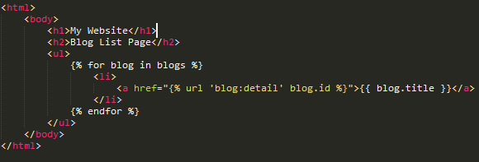
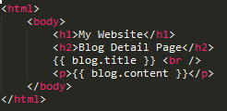
Template tags Organizing your HTML
index.html
list.html
detail.html

Slide 13
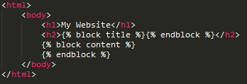
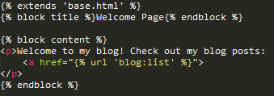
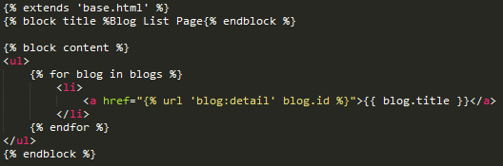
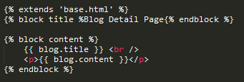
Organizing your HTML using {% block %} and {% extends %}
base.html
index.html
list.html
detail.html

Slide 14
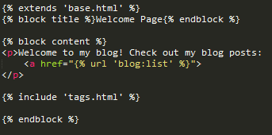
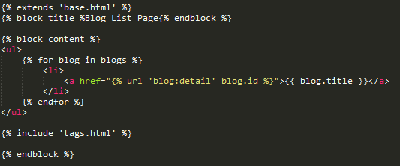

Template tags {% include %}
list.html
detail.html
tags.html

Slide 15
Filters |length
{% if messages|length >= 100 %}
You have lots of messages today!
{% endif %}

Slide 16
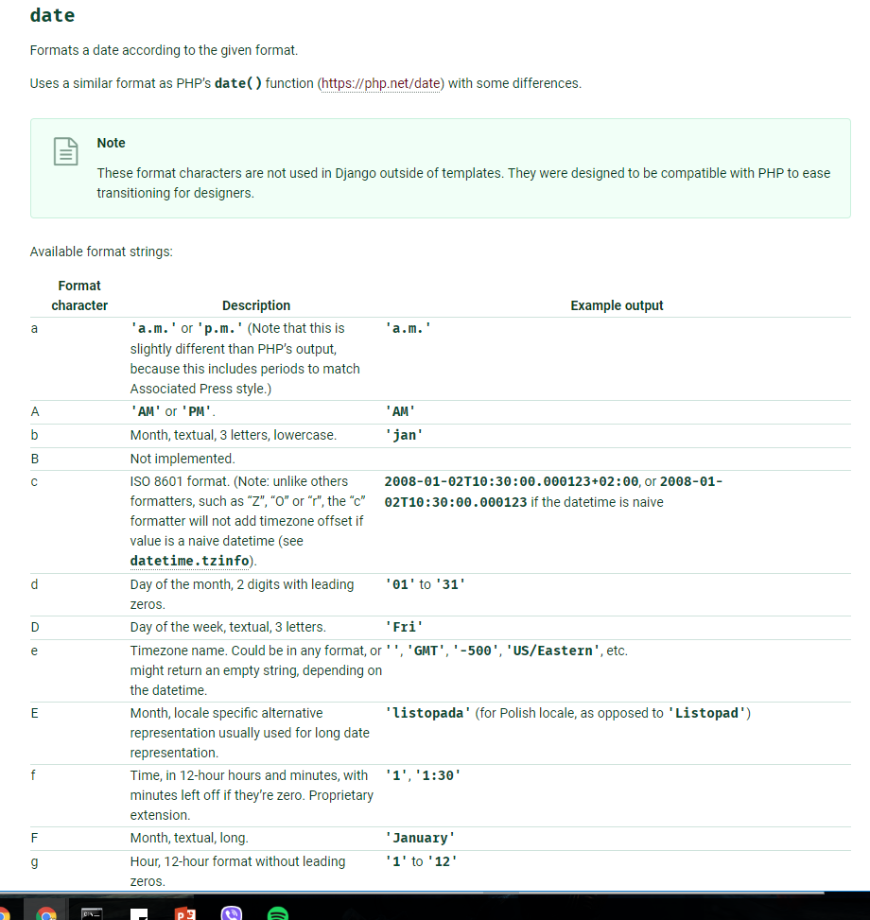
Filters |date

Slide 17
Filters |date
{{ value|date:"D d M Y" }}
Notes:
Sat 4 May 2019

Slide 18
Django’s Built in Template tags and filters
https://docs.djangoproject.com/en/2.2/ref/templates/builtins/

Slide 19
Notes: Django coding steps
1. Model – create models
2. View – create view
3. Template – create HTML
4. URL – register view in urls.py

Slide 20
Django Authentication (Login)
Using the food tracker project, create the view for the login page
food_tracker/food/views.py
def login(request):
if request.user.is_authenticated:
return HttpResponseRedirect(reverse_lazy('food:index'))
else:
return HttpResponseRedirect(reverse_lazy('auth_login'))

Slide 21
Django Authentication (Login)
Include Django’s default authentication in the urls.py
food_tracker/food_tracker/urls.py
from django.conf.urls import url, include
from django.contrib import admin
from django.contrib.auth import views as auth_views
urlpatterns = [
url(r'^admin/', admin.site.urls),
url(r'^', include(('food.urls',food), namespace="food")),
url(r'^accounts/login/$', auth_views.LoginView.as_view(template_name= 'login.html’), name='auth_login'),
url(r'^accounts/logout/$', auth_views.LogoutView.as_view(next_page='food:login’), name='auth_logout'),
]

Slide 22
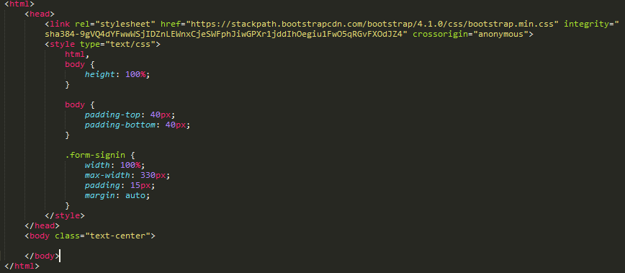
Django Authentication (Login)
Create login page
food_tracker/templates/login.html

Slide 23
Django Authentication (Login)
Update url patterns so that the default view for the blank pattern will be ‘login’
food_tracker/food/urls.py
from django.conf.urls import url
from .views import index, add_meal, delete_meal, update_meal, login
urlpatterns = [
url(r'^$', login, name='login'),
url(r'^index$', index, name='index'),
url(r'^add_meal$', add_meal, name='add-meal'),
url(r'^delete_meal/(?P<meal_id>\d+)$', delete_meal, name='delete-meal'),
url(r'^update_meal/(?P<meal_id>\d+)$', update_meal, name='update-meal'),
]

Slide 24
Django Authentication (Login)
Add Django auth forms in the login page
food_tracker/templates/login.html
…
<body class="text-center">
<form class="form-signin" method="POST" action="{% url 'auth_login' %}" role="form">
{% csrf_token %}
<h1>My Food Tracker</h1>
{{ form.username.label }}
{{ form.username }}
{{ form.password.label }}
{{ form.password }}
<button class="btn btn-lg btn-primary" type="submit">Sign in</button>
<input type="hidden" name="next" value="{% url 'food:index' %}" />
</form>
</body>
…

Slide 25
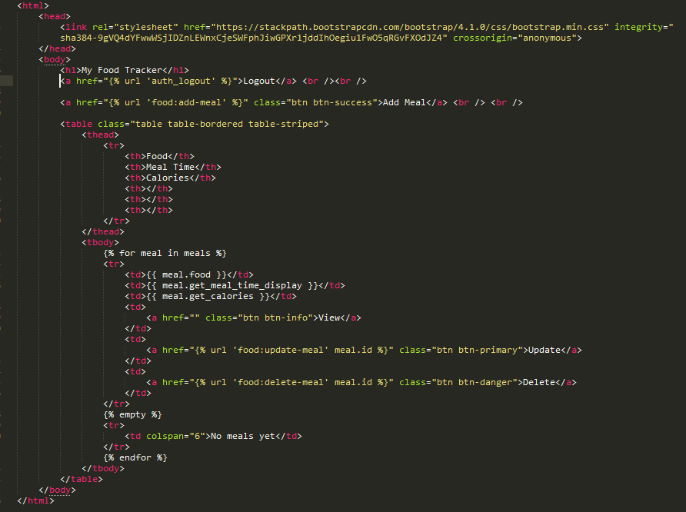
Django Authentication (Logout)
Add Django auth logout link
food_tracker/templates/list.html

Slide 26
Django Authentication (Change Password)
Add Django’s auth_views.password_change in urls.py
food_tracker/food_tracker/urls.py
from django.conf.urls import url, include
from django.contrib import admin
from django.contrib.auth import views as auth_views
from django.urls import reverse_lazy
urlpatterns = [
url(r'^admin/', admin.site.urls),
url(r'^', include(('food.urls',food), namespace="food")),
url(r'^accounts/login/$', auth_views.LoginView.as_view(template_name= 'login.html’), name='auth_login'),
url(r'^accounts/logout/$', auth_views.LogoutView.as_view(next_page='food:login’), name='auth_logout'),
url(r'^accounts/password/change$', auth_views.PasswordChangeView.as_view (template_name='password_change.html’,success_url=reverse_lazy(’food:login’)),name='auth_password_change'),
]

Slide 27
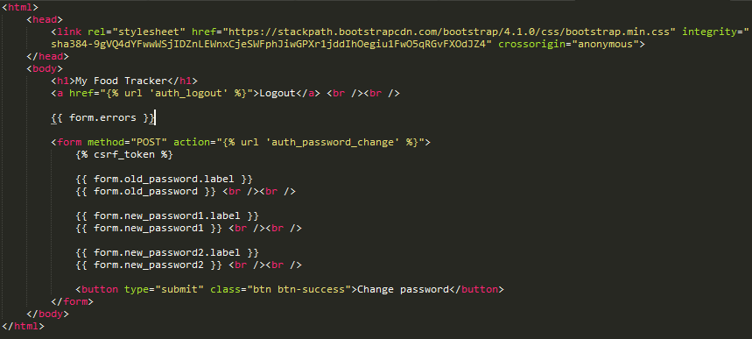
Django Authentication (Change Password)
Create password_change html page
food_tracker/templates/password_change.html

Slide 28
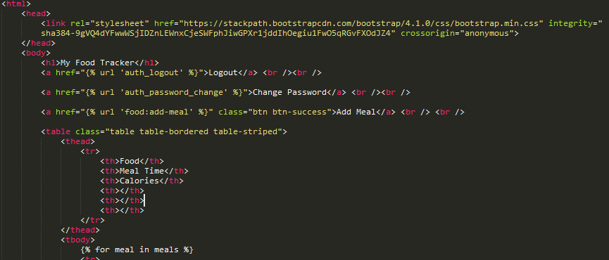
Django Authentication (Change Password)
Add change password link in the index.html
food_tracker/templates/list.html

Slide 29
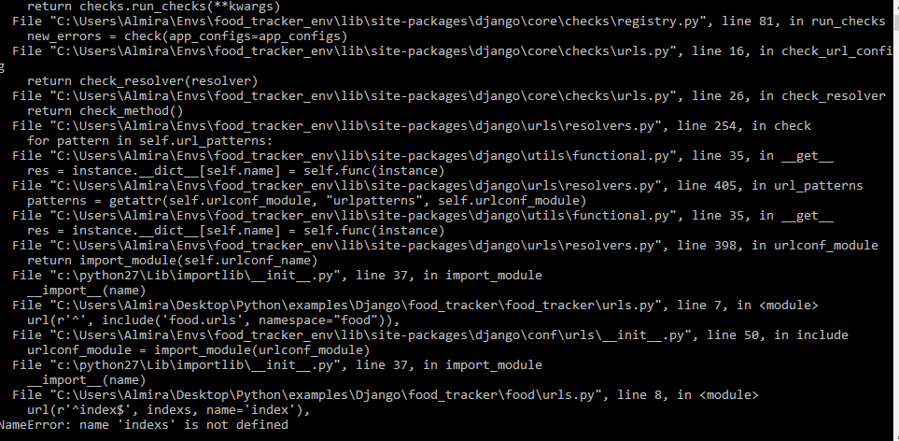
Debugging (Syntax Error)
File where the error occurred
Line number
Error Type

Slide 30
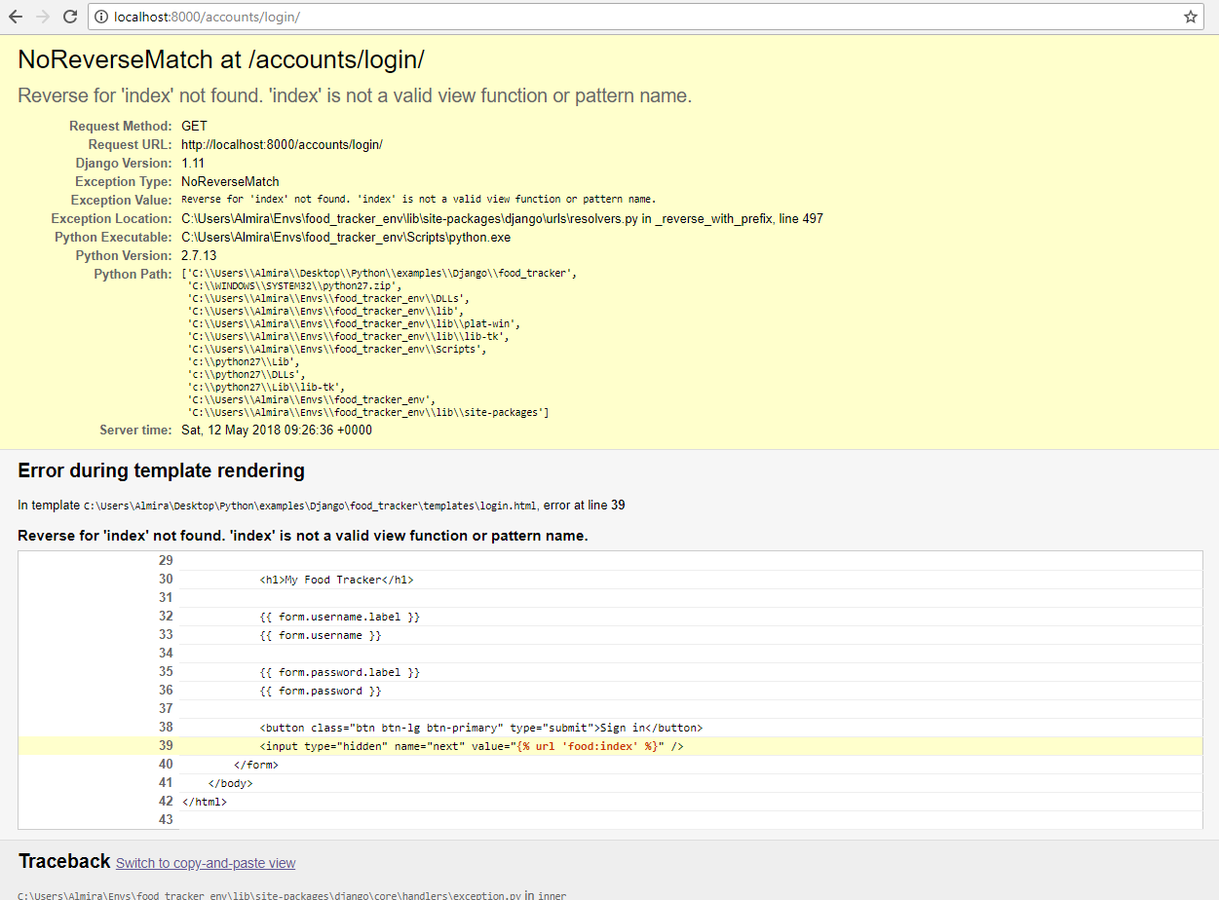
Debugging (Syntax Error)
File where the error occurred
Line number

Slide 31
Coding Style: Function
Name your functions as if it’s a command that you are giving to a class. i.e walk(), pop()
Do not use “camel case”, instead make use of “_”.

Slide 32
Coding Style: Class
Your class should use “camel case”. i.e. class AuthorizedRepresentative()
Try not to do too much in your __init__ functions. It makes them harder to use

Slide 33
Coding Style: Code
If you can’t read it out loud, it’s probably hard to read.
Try to do what other people are doing in Python until you ﬁnd your own style.
Once you ﬁnd your own style, do not be a jerk about it. Working with other people’s code is part of being a programmer, and other people have really bad taste.
Be consistent with the use of tabs and spaces

Slide 34
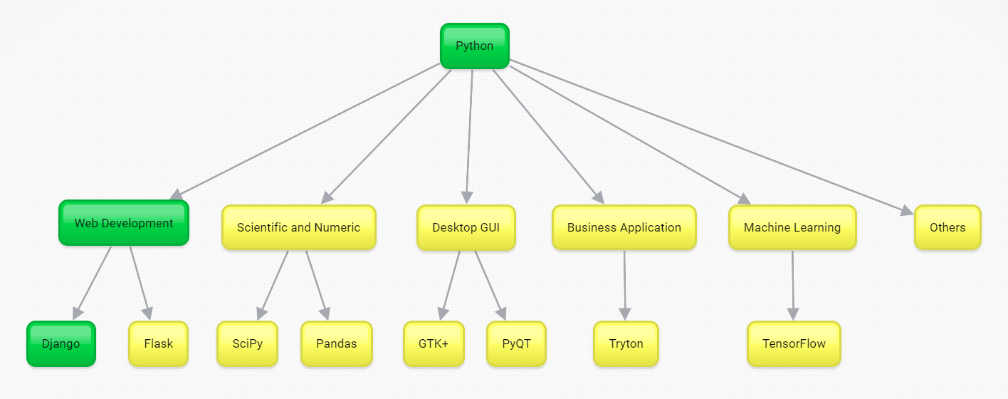
What’s next?

Slide 35
Deployment
https://guides.github.com/activities/hello-world/
How to deploy a Django App to Python Anywhere: https://www.youtube.com/watch?v=Y4c4ickks2A

